Slide 1
New Data on BTK Inhibitors for MCL :EHA 2025 ECHO Trial
Dr. Firas HUSSEIN
Hematology/Oncology
Chef of the department of Hematology
Lattakia University
Syrian association of oncology meeting
Damascus
4-6/12/2025

Slide 2
MCL: Prognostic Risk Factors
Risk factors are heterogeneous within a patient and between patients
MCL is biologically heterogeneous, and risk stratification incorporates multiple biologic factors
Low Risk
Low KI-67 (≤10%)
SOX-11 negative
IGHV hypermutated
Stable karyotype
High Risk
Blastic/blastoic/pleomorphic
High Ki-67 (>30%)
Complex karyotype
TP53 deletion or mutations
Indolent MCL
Classic MCL
Blastic MCL
Hoster. Blood. 2008;111:558.
Notes:
MCL, mantle cell lymphoma.

Slide 3
MCL: Prognostic Factors for Overall Survival
OS According to MIPI
Points | Age, Yr | ECOG PS | LDH/ULN, IU/L | WBC x 10⁹/L
0 | <50 | 0-1 | <0.67 | <6.7
1 | 50-59 | -- | 0.67-0.99 | 6.7-9.99
2 | 60-69 | 2-4 | 1.00-1.49 | 10.0-14.99
3 | ≥70 | -- | ≥1.50 | ≥15.0
1.0
+
+
+
+
+
+
+
+
+
+
+
+
+
+
+
+
+
+
+
+
+
+
+
+
+
+
+
+
+
+
+
+
+
+
+
+
0.8
+
+
+
+
+
+
+
+
+
+
+
+
+
+
+
+
+
0.6
+
+
+
+
+
+
+
+
+
+
+
+
+
+
+
+
+
+
+
+
+
+
+
+
+
+
+
+
+
+
+
+
+
OS (Probability)
+
+
+
+
+
0.4
+
+
+
+
+
+
+
Total Points | Risk | Patients, %
0-3 | Low | 44
4-5 | Intermediate | 35
6-11 | High | 21
+
+
+
Median OS
+
+
+
+
Low risk: NR Int risk: 51 mo High risk: 29 mo
+
0.2
+
+
+
+
+
0.0
0
12
24
36
48
60
72
84
96
Mo
Patients at Risk, n Low risk Int risk High risk
180 145 84
153 116 58
131 83 29
99 57 19
69 37 8
39 19 5
15 9 1
4 5 0
Hoster. Blood. 2008;111:558.
Notes:
ECOG, Eastern Cooperative Oncology Group; int, intermediate; LDH, lactate dehydrogenase; MCL, mantle cell lymphoma; MIPI, Mantle Cell Lymphoma International Prognostic Index; NR, not reached; OS, overall survival; PS, performance status; ULN, upper limit of normal; WBC, white blood cell.

Slide 4
MCL: Additional Prognostic Factor
Ki-67 Index
1.0
0.8
0.6
Probability
0.4
0.2
<10%, median not reached 10% to <30%, median not reached ≥30%, median: 3.4
P <.001
0
0
1
2
3
4
5
6
7
8
9
10
Yr From Registration
Hoster. JCO. 2016;34:1386.
Notes:
MCL, mantle cell lymphoma.

Slide 5
NORDIC MCL2/MCL3 Studies: TP53 Mutations Associated With Poor Outcomes With Chemoimmunotherapy/ASCT
Survival by TP53 Status
Survival by MIPI-c Index in TP53-Unmutated Cases
OS
PFS
No TP53 del (n = 147) TP53 del (n = 29)
No TP53 del (n = 147) TP53 del (n = 29)
OS
L (n = 52) LI (n = 42) HI (n = 27) H (n = 12)
100
100
100
80
80
80
60
60
60
%
%
%
40
40
40
20
P = .002
20
P = .003
20
0
0
0
P = .46
0
2
4
6
8
10
12
14
16
0
2
4
6
8
10
12
14
16
0
2
4
6
8
10
12
14
Yr
Yr
16
Yr
No TP53 mut (n = 156) TP53 mut (n = 20)
No TP53 mut (n = 156) TP53 mut (n = 20)
PFS
100
100
100
80
80
80
60
60
60
%
%
%
40
40
40
20
P = .0001
20
P < .0001
20
P = .31
0
0
0
0
2
4
6
8
10
12
14
16
0
2
4
6
8
10
12
14
16
0
2
4
6
8
10
12
14
16
Yr
Yr
Yr
Eskelund. Blood. 2017;130:1903.
Notes:
ASCT, autologous stem cell transplant; del, deletion; H, high; HI, high-intermediate; L, low; LI, low-intermediate; MIPI-c, Mantle Cell Lymphoma International Prognostic Index combined; mut, mutation; OS, overall survival; PFS, progression-free survival.

Slide 6
MCL: Who Can Undergo Watch and Wait?
Not blastoid morphology¹
Normal LDH²
Ki-67 <30%³
Less frequent or no B symptoms³
Mutated IGHV⁴
Non-nodal⁵
MIPI score is NOT defining characteristic
OS in MCL With Early vs Deferred Therapy⁶
1.0
Deferred Treatment
No
Yes
0.8
0.6
Survival Probability
0.4
0.2
Log rank P = .3524
0
0
1
2
3
4
5
6
7
8
9
10
11
12
13
14
15
16
17
18
Yr
1. Martin. JCO. 2022;[Epub]. 2. Abrahamsson. Blood. 2014;124:1288. 3. Abrisqueta. Ann Oncol. 2017;28:2489. 4. Orchard. Blood. 2003;101:4975. 5. Ondrejka. Haematologica. 2011;96:1121. 6. Calzada. Leuk Lymphoma. 2018;59:2862.
Notes:
LDH, lactate dehydrogenase; MCL, mantle cell lymphoma; MIPI, Mantle Cell Lymphoma International Prognostic Index; OS, overall survival.

Slide 7
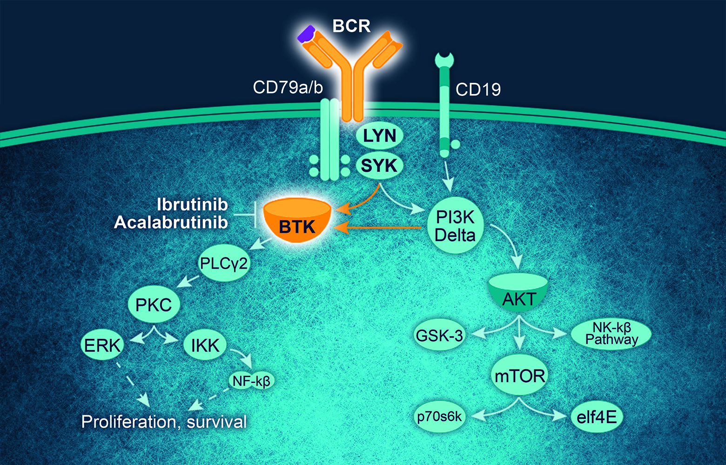
BTK Signaling Pathway
Survival of resting mature B-cells depend on BCR signaling
Some B-cell malignancies depend on tonic BCR signaling for tumor expansion and proliferation
BTK inhibitors block BCR signaling, induce apoptosis, and inhibit adhesion of malignant B-cells to microenvironment cells

Slide 8
Covalent vs Noncovalent BTK Inhibitors
Irreversible Covalent BTK Inhibitors
Ibrutinib
Acalabrutinib
Zanubrutinib
N
O
O
H₂N
N
NH
N
O
O
O
N
N
N
N
N
N
N
O
O
N
NH₂
N
N
NH
NH₂
Reversible Noncovalent BTK Inhibitors
Nemtabrutinib (ARQ-531)
Vecabrutinib
Fenebrutinib
Pirtobrutinib (LOXO-305)
N
HN
O
O
H
H
Cl
NH₂
N
N
H
H
N
F
N
N
N
F
N
O
O
NH
N
F
N
F
HO
O
O
N
N
NH
N
O
HN
N
HO
O
F
F
H₂N
F
N
N
O
N
Cl
N
O
H
O
F
Ran. Eur J Med Chem. 2022;229:114009.

Slide 9
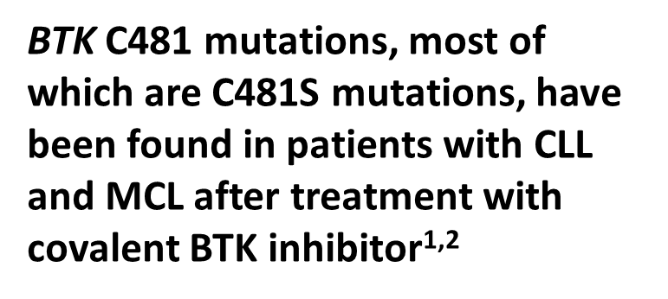
Covalent vs Noncovalent BTK Inhibitors
Covalent inhibitors bind to C481 residue and block ATP binding site
Noncovalent non C481 dependent binding
BCR
Pirtobrutinib Vecabrutinib Fenebrutinib Nemtabrutinib
CXCL12
IgH
CXCR4
P
BTK
PLCγ
CD79B
CD79A
P
Gβ
Gγ
Gα
Lyn
P
Lyn
P
P
P
PI3K
SYK
SYK
PKCβ
P
Ibrutinib Acalabrutinib Zanubrutinib
IKKγ
IKKα
IKKβ
MAPK
activation
Acquired Resistance to Covalent BTK Inhibitors
Covalent C481‒ dependent binding
AKT/mTOR activation
NF-κB activation
Adapted from Lewis. J Pers Med. 2021;11:764.

Slide 10
Covalent BTK Inhibitors in R/R MCL: Summary
It is important to ensure that therapy is personalized by accounting for individual patient characteristics and clinical scenarios
R/R MCL: Selection of Covalent BTKi
Currently, combination therapy is not recommended because of no clear benefit and potential for increased toxicity and financial burden
No longer indicated for R/R MCL in the US
With most robust data with longest follow-up; limiting toxicities
Most CNS penetration data; consider off label for CNS disease
Ibrutinib
No head-to-head comparison with zanubrutinib
FDA approved for R/R MCL
Associated with high rates of low-grade headaches
Acalabrutinib
No head-to-head comparison with acalabrutinib
FDA approved for R/R MCL
May have higher rates of neutropenia
Zanubrutinib
Following progression on covalent BTKi-based therapy, outcomes are poor; subsequent strategies under investigation include combination therapies and novel approaches
NCCN. Clinical practice guidelines in oncology: B-cell lymphomas. v.2.2024.
Notes:
CNS, central nervous system; MCL, mantle cell lymphoma; R/R, relapsed/refractory.

Slide 11
advances 2023 in MCL
BTK Inhibitor (Ibrutinib) change the Treatment in MCL in 2023 In first line?
Patients suitable for high-dose cytarabine and ASC(TRIANGLE Study )
Patients aged ≥65 no planned SCT(SHINE Study )

Slide 12
TRIANGLE: Study Design
Randomized, open-label, 3-arm phase III trial
Arm A*:
R-CHOP/R-DHAP x 3
(n = 288)
ASCT
Observation
Patients with previously untreated stage II-IV MCL; aged ≤65 yr; suitable for high-dose cytarabine and ASCT; ECOG PS 0-2
(N = 870)
Arm I*:
R-CHOP + I/R-DHAP x 3
(n = 290)
2-yr I
maintenance
Observation
Arm A + I*:
R-CHOP + I/R-DHAP x 3
(n = 292)
ASCT
2-yr I
maintenance
Observation
*R maintenance was added following national guidelines in all 3 arms (arm A + I: 57%; arm I: 54%; arm A: 58%).
Primary endpoint: FFS
Secondary endpoints: response rates, PFS, OS, safety
Dreyling. ASH 2022. Abstr 1.
Notes:
ASCT, autologous stem cell transplant; ECOG, Eastern Cooperative Oncology Group; FFS, failure-free survival; I, ibrutinib; MCL, mantle cell lymphoma; OS, overall survival; PS, performance status; R-CHOP, rituximab plus cyclophosphamide/doxorubicin/vincristine/prednisone; R-DHAP, rituximab plus cisplatin/dexamethasone/high‐dose cytarabine.

Slide 13
TRIANGLE Trial: Details and Potential Impact
Toxicity
Ibrutinib did not increase R-CHOP/R-DHAP toxicity
Ibrutinib did increase serious infection risk after ASCT
A + I more toxic vs A or I alone (grade 3-5 infections and infestations: A + I, 25%; A, 13%; I, 19%)
Conclusions
Addition of ibrutinib during induction and for 2 yr as maintenance may allow for subtraction of ASCT in first remission
Arm I (ibrutinib and no ASCT) appears to be the winner at this time
Best combination of efficacy and toxicity
Dreyling. ASH 2022. Abstr 1.
Notes:
A, acalabrutinib; ASCT, autologous stem cell transplant; I, ibrutinib; R-CHOP, rituximab plus cyclophosphamide/doxorubicin/vincristine/prednisone; R-DHAP, rituximab plus cisplatin/dexamethasone/high‐dose cytarabine.

Slide 14
SHINE: First-line Ibrutinib + Bendamustine/Rituximab Followed by Rituximab Maintenance in Older Patients With MCL
Multicenter, randomized, double-blind, placebo-controlled phase III trial
Stratification by MIPI score (low vs intermediate vs high)
BR induction for 6 cycles
If CR or PR
R maintenance Q8W for 12 cycles
Patients aged ≥65 yr with previously untreated stage II-IV MCL; no planned SCT
(N = 523)
Ibrutinib 560 mg QD until PD or unacceptable toxicity
BR induction for 6 cycles
If CR or PR
R maintenance Q8W for 12 cycles
Placebo until PD or unacceptable toxicity
Primary endpoint: investigator-assessed PFS (in ITT)
Key secondary endpoints: ORR, time to next treatment, OS, safety
Wang. ASCO 2022. Abstr LBA7502. Wang. NEJM. 2022;386:2482.
Notes:
BR, bendamustine/rituximab; CR, complete response; ITT, intention-to-treat; MCL, mantle cell lymphoma; MIPI, Mantle Cell Lymphoma International Prognostic Index; ORR, objective response rate; OS, overall survival; PD, progressive disease; PFS, progression-free survival; PR, partial response; R, rituximab; SCT, stem cell transplant.

Slide 15
SHINE: Conclusions
Adding ibrutinib to BR followed by rituximab maintenance vs placebo plus BR and rituximab maintenance improved PFS with similar safety
Median PFS prolonged by 2.3 yr (P = .011; HR: 0.75)
Investigators conclude that ibrutinib + BR followed by rituximab maintenance represents a strategy for first-line treatment of older patients with MCL, or those who are unsuitable for ASCT
- lack of OS benefit in 7 years FU -Toxicity related deaths in ibrutinib arm -risk of high financial burden in ibrutinib arm
Wang. ASCO 2022. Abstr LBA7502. Wang. NEJM. 2022;[Epub].
Notes:
ASCT, autologous stem cell transplant; BR, bendamustine/rituximab; MCL, mantle cell lymphoma; PFS, progression-free survival.

Slide 16
NCCN Guidelines: First-line Treatment for Stage II bulky or Stage III/IV MCL
Classical
TP53
Wildtype
Candidate for HDT/ASCT
Consider aggressive regimens
or clinical trial
Preferred Regimens: LyMA regimen, NORDIC regimen, TRIANGLE regimen, BR → rituximab + HD cytarabine
Other Recommended Regimens: HyperCVAD, RBAC500
Consolidation: HDT + ASCT with covalent BTKi x 2 yrs + R x 3 yr
Conflicting data for consolidation with HDT/ASCT after hyperCVAD
Ineligible for HDT/ASCT
Consider less-aggressive regimens
or clinical trial
Preferred Regimens: BR, VR-CAP, R-CHOP, Lenalidomide + rituximab
Other Recommended Regimens: Acalabrutinib + rituximab
Maintenance rituximab x 2-3 yrs recommended after R-CHOP or BR
Has not been evaluated after VR-CAP or R-BAC500
Classical
TP53 Mutated
Consider clinical trial
Aggressive induction: TRIANGLE regimen
Less aggressive regimens : Same as with TP53 wildtype
Suitable for all patients: Zanubrutinib/obinutuzumab/venetoclax
NCCN. Clinical practice guidelines in oncology: B-cell lymphomas. v.1.2025. nccn.org.
Notes:
ASCT, autologous stem cell transplant; BR, bendamustine plus rituximab; BTKi, BTK inhibitor; HD, high-dose; HDT, high-dose therapy; hyperCVAD, hyperfractionated cyclophosphamide/vincristine/doxorubicin/dexamethasone; MCL, mantle cell lymphoma; NCCN, National Comprehensive Cancer Network; R, rituximab; R-BAC, rituximab plus bendamustine/cytarabine; R-CHOP, rituximab plus cyclophosphamide/doxorubicin/vincristine/prednisone; R-DHA, rituximab plus dexamethasone/cytarabine; VR-CAP, bortezomib plus rituximab/cyclophosphamide/doxorubicin/prednisone.

Slide 17
Guideline-Recommended Regimens for Relapsed/Refractory MCL
Preferred Regimens for Second-line Therapy
Covalent BTK inhibitor (continuous) Acalabrutinib Zanubrutinib Lenalidomide + R
Other Recommended Regimen for Second-line Therapy
Ibrutinib ± R (continuous)
Additional Regimens Available for Second-line Therapy
Bendamustine + R (if bendamustine not previously given) Bendamustine + R + cytarabine (if not previously given) Bortezomib ± R R-DHAP (if not previously given) GemOx + R Ibrutinib + venetoclax Venetoclax ± R
Third-line and Beyond Therapy
Noncovalent BTK inhibitor Pirtobrutinib Anti-CD19 CAR T-cell therapy Brexucabtagene autoleucel Lisocabtagene autoleucel
How did we get here?
NCCN. Clinical practice guidelines in oncology: B-cell lymphomas. v.3.2024.
Notes:
GemOx, gemcitabine/oxaliplatin; MCL, mantle cell lymphoma; R, rituximab; R-DHAP, rituximab plus dexamethasone/cytarabine/cisplatin.

Slide 18
ECHO Trial : Acalabrutinib + BR vs Placebo + BR in Older Patients With Previously Untreated MCL
International, randomized, double-blind phase III trial
Primary endpoint: PFS (IRC)
Key secondary endpoints: ORR (IRC), OS, safety
Stratified by sMIPI score (low vs intermediate vs high), region (N America vs W Europe vs other)
6 x 28-day cycles
Acalabrutinib 100 mg PO BID +
Bendamustine 90 mg/m² IV on Days 1, 2 +
Rituximab 375 mg/m² IV on Day 1
(n = 299)
Acalabrutinib until PD or toxicity; if ≥PR, maintenance rituximab every 2 cycles x 2 yr
Patients aged ≥65 yr with previously untreated MCL; ECOG PS ≤2
(N = 598)
Crossover permitted after PD
Placebo PO BID +
Bendamustine 90 mg/m² IV on Days 1, 2 +
Rituximab 375 mg/m² IV on Day 1
(n = 299)
Placebo until PD or toxicity; if ≥PR, maintenance rituximab every 2 cycles x 2 yr
Dreyling. EHA 2025. Abstr S233. Dreyling. ICML 2025. Abstr 046. NCT02972840.

Slide 19
ECHO: Baseline Characteristics
Characteristic, n (%) | Acala + BR (n = 299) | Pbo + BR (n = 299)
Median age, yr (range) ≥75 yr, n (%) | 71 (65-85) 84 (28.1) | 71 (65-86) 77 (25.8)
Male | 214 (71.6) | 209 (69.9)
ECOG PS 1 2 | 129 (43.1) 12 (4.0) | 132 (44.1) 23 (7.7)
Tumor bulk ≥5 cm | 112 (37.5) | 113 (37.8)
Blastoid/ pleomorphic histology | 41 (13.7) | 38 (12.7)
Characteristic, n (%) | Acala + BR (n = 299) | Pbo + BR (n = 299)
sMIPI score Low risk Intermediate risk High risk | 99 (33.1) 128 (42.8) 72 (24.1) | 101 (33.8) 125 (41.8) 73 (24.4)
Extranodal disease | 264 (88.3) | 277 (92.6)
TP53 status, n (%) Mutated Unmutated Unknown, n | 22 (7.4) 97 (32.4) 180 | 29 (9.7) 83 (27.8) 187
Ki-67 ≥30% | 139 (46.5) | 147 (49.2)
Wang. EHA 2024. Abstr LB3439.
Notes:
Acala, acalabrutinib; BR, bendamustine/rituximab; ECOG, Eastern Cooperative Oncology Group; Pbo, placebo; PS, performance status; sMIPI, simplified Mantle Cell Lymphoma International Prognostic Index.

Slide 20
ECHO: Response
High-Risk Population
Total Population
100
95% CI: 84.9-93.6
95% CI: 78.9-89.4
95% CI: 87.3-93.8
95% CI: 83.9-91.3
80
21.9
24.4
37.2
34.4
60
CR PR
Patients (%)
40
66.6
67.9
47.5
53.5
20
0
ABR (n = 187)
PBR (n = 183)
ABR (n = 299)
PBR (n = 299)
 | ORR | CR
Difference (ABR vs PBR) | 5.1% | 20.4%
95% CI | -1.7 to 12.1 | 10.4 to 30.0
P value | .1382 | <.0001
 | ORR
Difference (ABR vs PBR) | 3.0%
95% CI | -2.0 to 8.1
P value | .2196
Dreyling. EHA 2025. Abstr S233. Dreyling. ICML 2025. Abstr 046.

Slide 21
ECHO: Best Overall Response
Best Overall Response, % | Acala + BR (n = 299) | Pbo + BR (n = 299)
ORR | 91.0 | 88.0
CR | 66.6 | 53.5
PR | 24.4 | 34.4
CR rate was 13% higher with Acala + BR vs Pbo + BR
Wang. EHA 2024. Abstr LB3439.
Notes:
Acala, acalabrutinib; BR, bendamustine/rituximab; CR, complete response; Pbo, placebo; PR, partial response.

Slide 22
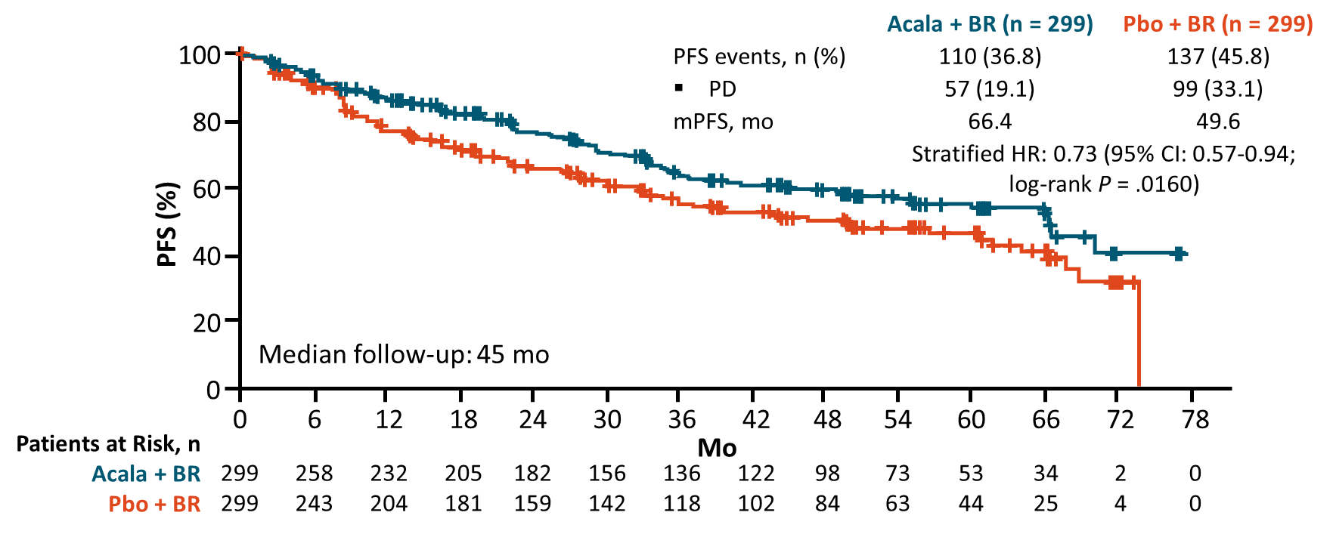
ECHO: PFS (Primary Endpoint)
High-risk Population
Total Population
 | Acala + BR (n = 187) | Pbo + BR (n = 183)
PFS events, n (%) PD | 83 (44.4) 44 (23.5) | 96 (52.5) 71 (38.8)
mPFS, mo | 49.5 | 36.0
 | Unstratified HR: 0.74 (95% CI: 0.55-0.99; log-rank P = .0432)
 | Acala + BR (n = 299) | Pbo + BR (n = 299)
PFS events, n (%) PD | 110 (36.8) 57 (19.1) | 137 (45.8) 99 (33.1)
mPFS, mo | 66.4 | 49.6
 | Unstratified HR: 0.73 (95% CI: 0.57-0.94; log-rank P = .0160)
100
100
+
+
+
+
+
80
+
80
+
+
+
+
+
+
+
60
+
+
+
+
60
+
+
+
PFS (%)
+
+
+
+
PFS (%)
+
+
+
+
+
+
+
+
+
+
+
+
+
+
+
+
+
40
+
+
+
+
+
40
+
+
+
+
+
+
Acala + BR PB + BR
+
20
+
20
Median follow-up: 45 mo
0
0
0
6
12
18
24
30
36
42
48
54
60
66
72
0
6
12
18
24
30
36
42
48
54
60
66
72
78
Patients at Risk, n Acala + BR Pbo + BR
Mo
Patients at Risk, n Acala + BR Pbo + BR
Mo
187 183
159 143
138 113
123 100
105 87
91 78
81 64
72 55
58 44
44 31
34 21
22 12
0 2
299 299
258 243
232 204
205 181
182 159
156 142
136 118
122 102
98 84
73 63
53 44
34 25
2 4
0 0
After PD, 53.5% of patients (38/71) with high-risk disease who progressed on Pbo crossed over to acalabrutinib
High-risk patients had at least one of: blastoid variant disease, Ki-67 >30%, TP53 mutation, high-risk MIPI, or pleomorphic histology.
Acalabrutinib + BR significantly prolonged mPFS by ~17 mo vs Pbo + BR
Of the 99 patients with PD on Pbo + BR, 69% subsequently received a BTK inhibitor
Dreyling. EHA 2025. Abstr S233. Dreyling. ICML 2025. Abstr 046.

Slide 23
ECHO: PFS in Patients With Biological Risk Factors
Patients With Ki-67 ≥30%, Blastoid/ Pleomorphic Histology, and/or TP53 Mutation
Patients With Blastoid/Pleomorphic Histology
 | Acala + BR (n = 155) | Pbo + BR (n = 157)
PFS events, n (%) PD | 66 (42.5) 33 (21.3) | 85 (54.1) 61 (38.9)
mPFS, mo | 49.5 | 33.2
 | Unstratified HR: 0.66 (95% CI: 0.48-0.91; log-rank P = .0119)
 | Acala + BR (n = 41) | Pbo + BR (n = 38)
PFS events, n (%) PD | 21 (51.2) 11 (26.8) | 24 (63.2) 20 (52.6)
mPFS, mo | 34.8 | 11.1
 | Unstratified HR: 0.59 (95% CI: 0.33-1.07; log-rank P = .0775)
100
+
100
+
+
+
+
+
+
+
+
+
80
+
+
80
+
+
+
+
+
+
+
+
+
+
+
+
60
+
+
+
+
+
60
+
PFS (%)
+
+
+
+
+
+
+
PFS (%)
+
+
+
+
+
+
+
+
+
+
+
+
+
40
+
+
+
+
+
40
+
+
+
+
+
+
+
+
+
+
+
+
+
+
+
+
+
+
+
+
+
20
Acala + BR PB + BR
+
20
+
+
0
0
0
6
12
18
24
30
36
42
48
54
60
66
72
78
0
6
12
18
24
30
36
42
48
54
60
Patients at Risk, n Acala + BR Pbo + BR
Mo
Patients at Risk, n Acala + BR Pbo + BR
Mo
155 157
133 125
115 98
102 85
88 72
76 64
67 51
59 43
45 34
34 24
26 17
18 9
0 1
0 0
41 38
32 23
26 16
23 14
21 11
18 10
14 9
13 6
8 3
6 1
5 0
3
0
In this grouping, MIPI, which was considered less important than other biological risk factors in phase II ALTAMIRA, was removed
When only those with a Ki-67 index ≥30% and/or blastoid/pleomorphic histology were analyzed, PFS was longer with ABR vs PBR (HR: 0.64, 95% CI: 0.46-0.90; P = .0092)
Patient with blastoid/pleomorphic histology had longer PFS with acalabrutinib + BR, 34.8 vs 11.1 mo (HR: 0.59 (95% CI: 0.33-1.07; P = .0775)
Dreyling. EHA 2025. Abstr S233. Dreyling. ICML 2025. Abstr 046.
Notes:
ABR, acalabrutinib + BR; PBR, placebo + BR

Slide 24
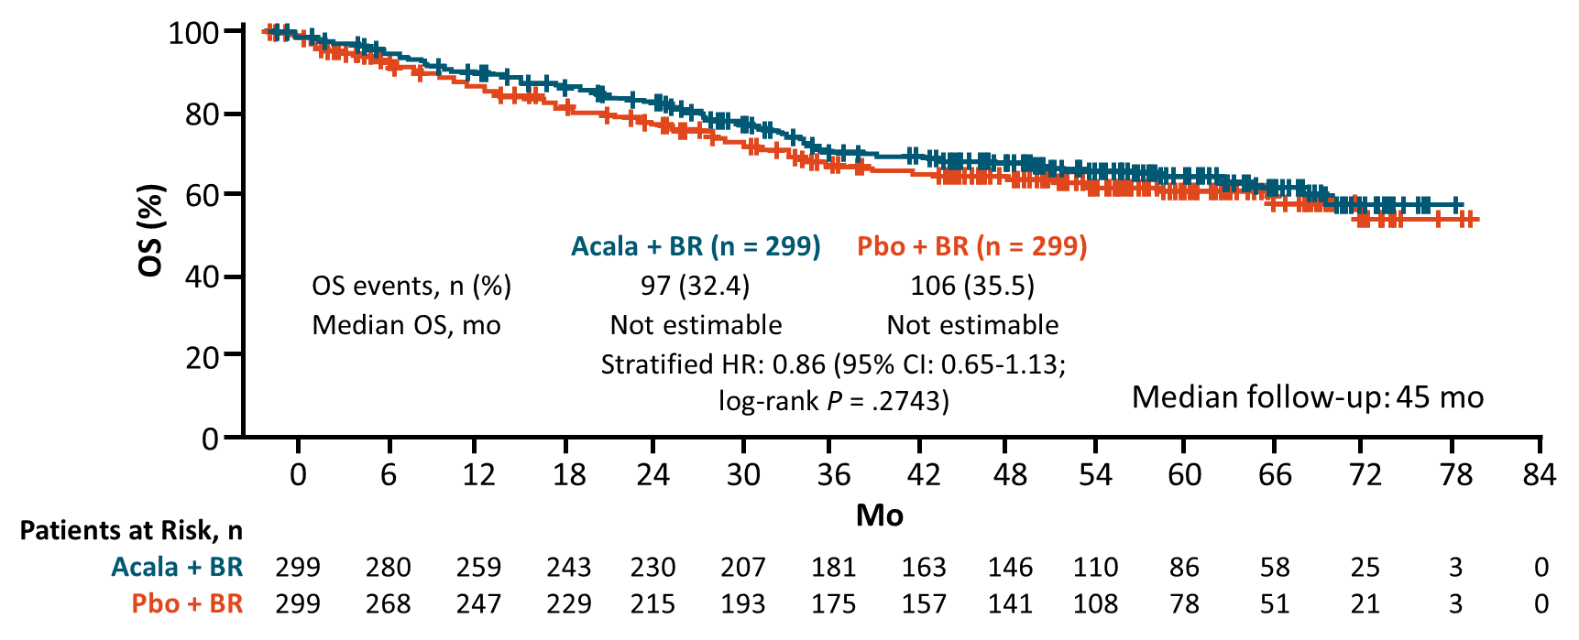
ECHO: OS Including Crossover
High-Risk Population
Total Population
 | Acala + BR (n = 187) | Pbo + BR (n = 183)
OS events, n (%) | 77 (41.2) | 80 (43.7)
Median OS, mo | Not estimable | 68.0
 | Unstratified HR: 0.87 (95% CI: 0.64-1.19; log-rank P = .3913)
 | Acala + BR (n = 299) | Pbo + BR (n = 299)
OS events, n (%) | 97 (32.4) | 106 (35.5)
Median OS, mo | Not estimate | Not estimate
 | Stratified HR: 0.86 (95% CI: 0.65-1.13; log-rank P = .2743)
100
+
100
+
+
+
+
80
+
+
80
+
+
+
+
+
+
+
+
+
+
60
+
+
60
+
+
+
+
+
+
+
+
+
+
+
+
+
+
+
+
+
+
+
+
+
+
+
+
+
+
+
+
+
+
+
+
+
+
+
+
+
+
+
+
+
+
+
+
+
+
OS (%)
+
+
OS (%)
+
+
+
+
40
+
40
+
+
20
Acala + BR PB + BR
20
Median follow-up: 45 mo
0
0
0
6
12
18
24
30
36
42
48
54
60
66
72
78
0
6
12
18
24
30
36
42
48
54
60
66
72
78
84
Patients at Risk, n Acala + BR Pbo + BR
Mo
Patients at Risk, n Acala + BR Pbo + BR
Mo
187 183
173 159
156 144
145 133
137 121
122 109
108 98
95 88
83 75
60 59
51 38
33 26
17 9
2 0
299 299
280 268
259 247
243 229
230 215
207 193
181 175
163 157
146 141
110 108
86 78
58 51
25 21
3 3
0 0
OS maturity rate = 42%
Dreyling. EHA 2025. Abstr S233. Dreyling. ICML 2025. Abstr 046.

Slide 25
ECHO: Safety
AE, n (%) | Acala + BR (n = 297) | Pbo + BR (n = 297)
Any TEAE Grade ≥3 Grade 5 | 296 (99.7) 264 (88.9) 36 (12.1) | 294 (99.0) 262 (88.2) 30 (10.1)
Serious AE Grade ≥3 | 205 (69.0) 191 (64.3) | 184 (62.0) 166 (55.9)
TEAE related to Acala/Pbo | 202 (68.0) | 165 (55.6)
TEAE leading to Acala/Pbo d/c | 127 (42.8) | 92 (31.0)
Deaths, n (%) | Acala + BR (n = 299) | Pbo + BR* (n = 299)
Total | 97 (32.4) | 106 (35.5)
Due to PD | 30 (10.0) | 43 (14.4)
≤30 days after last dose due to AE | 27 (9.0) | 27 (9.0)
>30 days after last dose due to AE | 19 (6.4) | 14 (4.7)
Other† | 14 (4.7) | 16 (5.4)
Unknown | 7 (2.3) | 6 (2.0)
*Including crossover. †Includes fatal AEs that occurred >30 days after final study drug dose and that were not considered related to tx.
Wang. EHA 2024. Abstr LB3439.
Notes:
Acala, acalabrutinib; AE, adverse event; BR, bendamustine/rituximab; d/c, discontinuation; Pbo, placebo; PD, progressive disease; TEAE, treatment-emergent adverse event; tx, treatment.

Slide 26
ECHO: AEs of Interest and COVID-19–Related Events
AE of Interest, n (%) | Acala + BR (n = 297) |  | Pbo + BR (n = 297)
 | Any Grade | Grade ≥3 | Any Grade | Grade ≥3
Atrial fibrillation | 18 (6.1) | 11 (3.7) | 13 (4.4) | 5 (1.7)
Hypertension | 36 (12.1) | 16 (5.4) | 47 (15.8) | 25 (8.4)
Major bleeding | 7 (2.4) | 6 (2.0) | 16 (5.4) | 10 (3.4)
Infections | 232 (78.1) | 122 (41.1) | 211 (71.0) | 101 (34.0)
Second primary malignancies (excluding nonmelanoma skin) | 29 (9.8) | 16 (5.4) | 32 (10.8) | 20 (6.7)
COVID-19–Related AE, n (%) | Acala + BR (n = 297) | Pbo + BR (n = 297)
Any Grade ≥3 Grade 5 | 121 (40.7) 60 (20.2) 28 (9.4) | 88 (29.6) 50 (16.8) 20 (6.7)
Serious AE Grade ≥3 | 60 (20.2) 58 (19.5) | 52 (17.5) 48 (16.2)
AE leading to Acala/Pbo d/c | 31 (10.4) | 19 (6.4)
Median treatment exposure
Acala + BR: 29 mo (range: 0.1-80.1)
Pbo + BR: 25 mo (range: 0.03-76.4)
Wang. EHA 2024. Abstr LB3439.
Notes:
Acala, acalabrutinib; AE, adverse event; BR, bendamustine/rituximab; d/c, discontinuation; Pbo, placebo.

Slide 27
ECHO: Conclusions
PFS in previously untreated high‑risk MCL (defined as Ki‑67 ≥30%, blastoid/pleomorphic histology, and/or TP53 mutation)
Acalabrutinib + BR significantly prolonged PFS vs placebo + BR; mPFS 49.5 vs 33.2 mo
Subgroup (Ki‑67 ≥30% and/or blastoid/pleomorphic histology): PFS was longer with ABR vs PBR (HR: 0.64, 95% CI: 0.46-0.90; P = .0092)
Blastoid/pleomorphic histology: mPFS 34.8 vs 11.1 mo (HR: 0.59; 95% CI: 0.33-1.07; P = .0775)
CR rate (high‑risk population): 67.9% with acalabrutinib + BR vs 47.5% with placebo + BR; difference 20.4% (95% CI: 10.4-30.0; P <.0001)
OS (high‑risk population): trend favoring acalabrutinib + BR; median OS NE vs 68.0 mo (HR: 0.87; 95% CI: 0.64-1.19; P = .3913)
Consistent improvement in efficacy with acalabrutinib + BR vs placebo + BR shown across the total and high‑risk patient populations
Dreyling. EHA 2025. Abstr S233. Dreyling. ICML 2025. Abstr 046.
Notes:
ABR, acalabrutinib + BR; PBR, placebo + BR; MCL, mantle cell lymphoma

Slide 28
BTK In Mantle Cell lymphoma 2025
BTK inhibitors FDA approved for patients with R/R mantle-cell lymphoma more than one prior therapy
On January 27, 2023, FDA granted accelerated approval to pirtobrutinib for R/R MCL after ≥2 lines of systemic therapy, including a BTK inhibitor
TRIANGLE regimen : (ibrutinib and no ASCT) appears to be the winner in Patients with previously untreated stage II-IV MCL; aged ≤65 yr; suitable for high-dose cytarabine and ASCT
ECHO trial :efficacy with acalabrutinib + BR vs placebo + BR in high‑risk Older Patients With Previously Untreated MCL

Slide 29
Thank you……..

